Slide 1

iPad Order Conditions (VOTF Orders)
How to bring us forward!

Slide 2
Agenda
What Are iPad Orders?
Payment Methods & Order Timing
Returns, Refunds & Exchanges
Shipping Rules (Domestic & International)
Faltas Picking & Partial Fulfillment
How to Recognize iPad Orders
Final Tips
|

Slide 3

What Are iPad (VOTF) Orders?
VOTF = "Venta Online en Tienda Física"
Orders placed in-store by staff via iPad or POS when items are out of stock
Online products purchased and shipped, but processed like store sales
Appear on mixed receipts when combined with in-store items
|

Slide 4

Payment Methods & Order Timing
Accepted payment methods (in-store only):
Cash, card (via dataphone), store gift vouchers ❌ Not accepted: PayPal, Klarna, COD
🕒 Payment rules:
Partial payments are allowed (pay remainder on pickup)
Customers can delay payment up to 2 hours after order creation
If not paid in time, status becomes “CADUCADO” (Expired) in Manto 📄 Customer Service cannot see payment method—only appears on the store receipt

Slide 5
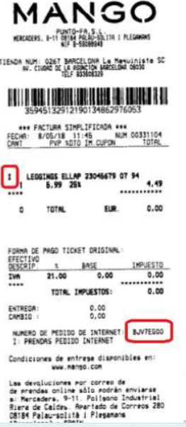
Returns, Refunds & Exchanges
Returns allowed, but under strict rules:
In-store: requires original purchase receipt
By mail: use “My Purchases” > “I’m not registered - View a specific order”
Not available in all countries — check Help > Exchanges & Returns
🛑 Common refund error:
If store refunds as online order, refund fails ✅ Correct way: process as store refund, ensure order number is on receipt
🔄 No exchanges (e.g., size or color)
If the customer wants a different item: store refunds and creates a new sale (if item is in stock)

Slide 6
Shipping Rules (Domestic & International)
Domestic shipping options:
To customer’s home address in same country
To the store where order was placed ❌ Cannot send to another store in the same country
🌍 Cross-country orders (between these countries only):
Spain, France, UK, Germany, Portugal, Austria, Belgium, Netherlands, Ireland, Czech Republic ✅ Home delivery only ❌ Cannot return in-store; returns by mail at customer’s cost ✅ Local pricing from the purchase country is kept
|

Slide 7
Faltas Picking & Recognizing iPad Orders
Faltas Picking – Refund Scenarios:
Canceled/partial home delivery: refund via bank transfer or in-store
Partial store delivery: only in-store refund possible
🧾 How to identify iPad orders:
Return form: marked with "PREMIUM"
Purchase receipt:
Items from iPad marked with letter "I"
Order number listed
May appear with in-store items on a mixed receipt
|

Slide 8
Summary & Final Tips
✔ iPad/VOTF orders = online items purchased in-store ✔ Follow store payment and refund rules ✔ ❌ No cancellations or exchanges ✔ Refund must be processed correctly ✔ Check country-specific return and shipping options ✔ Recognize iPad orders on receipts by “I” and “PREMIUM”

Slide 9

Let´s be brilliant together!
Quality and Training Team Mango and Transcom,
April 2025
|

